Slide 1
Welcome to all
for the MHRM Online lecture
By
Dr. Dhiraj Ovhal
HOD of Commerce

Slide 2
Chapter -2
Marketing Decision –I
(Product and Price)

Slide 3
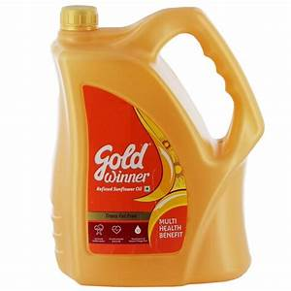
Q.6 Packaging and Essential
Meaning:-
Packing means to protect and cover ,wrapping the products and packaging means not only protect and cover, wrapping but also attractive container and special design to attract customers.

Slide 4
1 . Suitability
2.Attractivness
3.Protection
4.Convenience
5.Economy
6.Easy to handle
7.lightness
8.Reuse /Environmental friendly
Essential:-

Slide 5
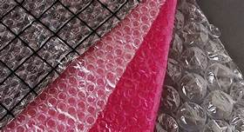
Suitability :-
A good package must be suitable to the product. For example , medicines must preferably come in glass bottles and not in plastic bottles.
Again, glassware should be packed with cushioning materials

Slide 6
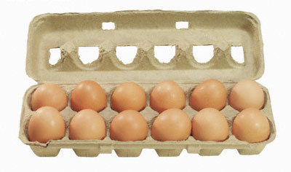
3. Protection
It means to protect and cover ,wrapping the products and packaging means not only protect and cover, wrapping but also attractive container and special design to attract customers.

Slide 7
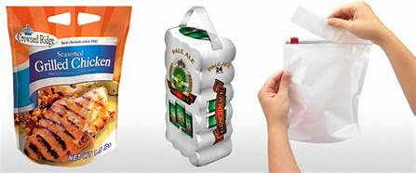
4. Convenience :-
Packages should offer convenience the case of carrying, handling and using the product. They must come in convenient sizes and shapes as per the requirements of the customers.

Slide 8
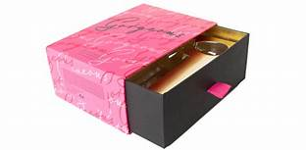
2. Attractiveness :-
Packages must be attractive. They should attract the attention of the prospects or buyers and make them to buy the duct. It should have the advertising value.
Packages must be convenient to display in the showcases. They should be attractive, compact and conveniently displayable.

Slide 9
5. Economy :-
The cost of packaging must be reasonable
It should be fashionable or daily use

Slide 10
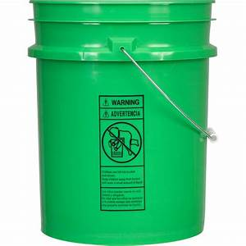
6. Easy to handle :-
It should be easy to handle properly
It should make such system to useful at the time to carry and use

Slide 11
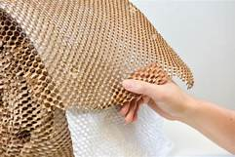
7. Lightness:-
Packaging should be in lighter weight so that easy to handle and carry.
So that always use light materials to pack the products such as papers, boxes, bottles, straw. saw dust, etc.

Slide 12
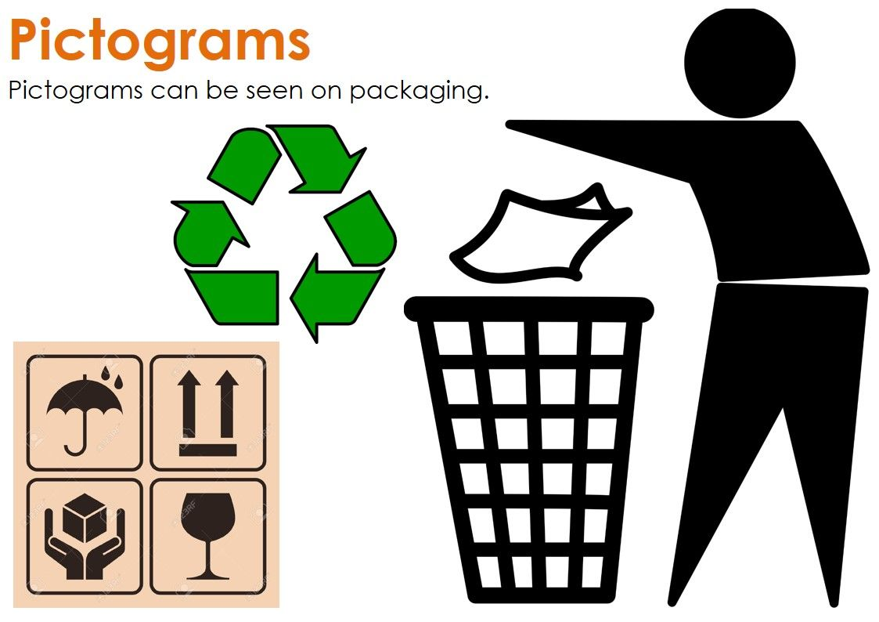
8. Reuse /Environmental friendly:-
Use environmental friendly packaging
Should not create waste
Recycling and reuse

Slide 13
1 . Suitability
2.Attractivness
3.Protection
4.Convenience
5.Economy
6.Easy to handle
7.lightness
8.Reuse /Environmental friendly
Essential:-

Slide 14
Thank You

Slide 15
Attendance Link
https://forms.gle/Xqvykv5vfEi1zpyF7
Last point mention today date in feedback link

